Slide 1
FINAL EXAM
students:
1.Ahmed Iyad Alhopi
2.Wajdy M.kgamees Shaheen
3.Shehab Essam Shaat

Slide 2
Project Axes :
1.Used classes and their own methods .
2.Design and connect with each other .
3.Data storage and management.

Slide 3
1.The Classes :
1.User.
2.Student.
3.Staff.
4.Book.
5.Book Loaning.
6.Book Return.

Slide 4
User
+ USER_ID : String
-idnumberUser: string
-firstname: string
-lastname: string
-password: string
-phonenumber: string
+ User()
+ User (idnumberUser: string, firstname: string, lastname: string , password: string, phonenumber: string)
+ toString() : String
+ equals(obj : Object) : boolean
+ login(user_name :String, password : String): boolean
+ addUser (id : String, fname : String , lname : String , password: String , phone: String ): void
+ check (id : String, fname : String , lname : String , pass1: String , pass2: String , phone : String ): void
User

Slide 5
Student
-idnumberStudent: string
-firstname: string
-lastname: string
-phonenumber : string
-major: string
+ Student ()
+ Student (idnumberStudent : string, firstname: string, lastname: string , phonenumber : string, major : string)
+ toString() : String
+ equals(obj : Object) : boolean
+ addStudent (id : String, fname : String , lname : String , phone : String , major : String ): void
+ check (id : String, fname : String , lname : String , phone : String , major : String): void
Student

Slide 6
Staff
Staff
-idnumberStaff : string
-firstname: string
-lastname: string
-phonenumber : string
-department : string
+ Staff()
+ Staff(idnumberStudent : string, firstname: string, lastname: string , phonenumber : string, major : string)
+ toString() : String
+ equals(obj : Object) : boolean
+ addStaff (id : String, fname : String , lname : String , phone : String, department : String ): void
+ check (id : String, fname : String , lname : String , phone : String , department: String): void

Slide 7
Book
-idnumberBook: string
-title: string
-publisher: string
-author: string
-year_ofpublication: string
-number_copies : int
- editions_book: int
- financialvalue : double
- status : boolean
+ Book()
+ Book (id : String , title : String , publisher : String , author : String , year_ofpublication : String , number_copies : int , financialvalue : double )
+ toString() : String
+ equals(obj : Object) : boolean
Book
Book
+ addBook(id : String , title : String , publisher : String , author : String , year_ofpublication : String , number_copies : int , financialvalue : double ): void
+ check (id : String, title : String , publisher : String , author : String , year_ofpublication : String): void
+ search (id : String ): ResultSet

Slide 8
Book_Loan
-librarian_number: string
-borrowing_number: string
-book_number: string
-borrowing_date: string
-borrowing_enddate: string
-edition: string
+ Book_Loan()
+ Book_Loan (librarian_number: String , borrowing_number: String , book_number: String , borrowing_date: String , borrowing_enddate: String , edition : String )
+ toString() : String
+ equals(obj : Object) : boolean
+ borrowBook(n : int , u_id : String , borr_id : String , b_id : String ): void
+ checkint (borr_id : String , b_id : String ): void
Book Loaning

Slide 9
Book_return
-librarian_number: string
-borrowing_number: string
-book_number: string
-borrowing_date: string
-borrowing_enddate: string
-borrowing_late: int
- financial : double
+ Book_return()
+ Book_return (librarian_number: String , borrowing_number: String , book_number: String , borrowing_date: String , borrowing_enddate: String , borrowing_late : int , financial : double )
+ toString() : String
+ equals(obj : Object) : boolean
+ returnBook(n : int , u_id : String , borr_id : String , b_id : String ): void
+ checkint (borr_id : String , b_id : String , n int ): void
Book Return

Slide 10
2.Graphic Interfaces :
1.login.
2.Admin login.
3.Regester.
4.DashBord.
5.Add student.
6.Add staff.
7.Add book.
8.Search book.
9.Loaning student.
10.Loaning staff.
11. Borrow Staff.
12. Borrow student.
13.Return book.

Slide 11
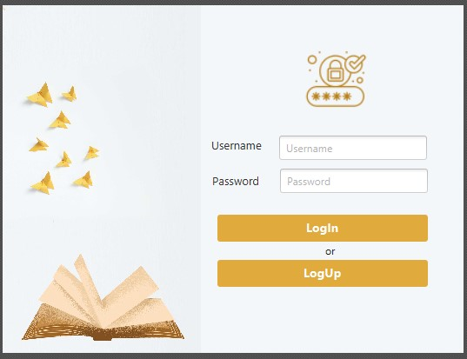
login

Slide 12
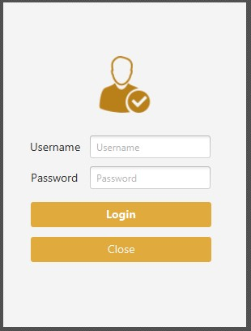
Admin login.

Slide 13
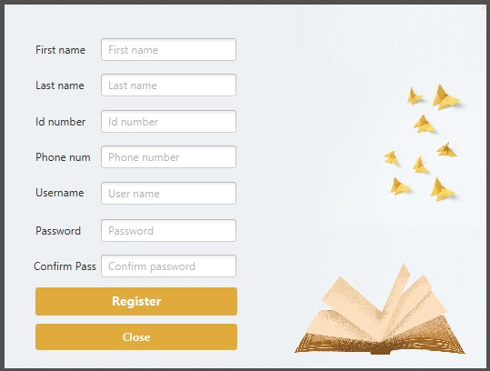
Register :

Slide 14
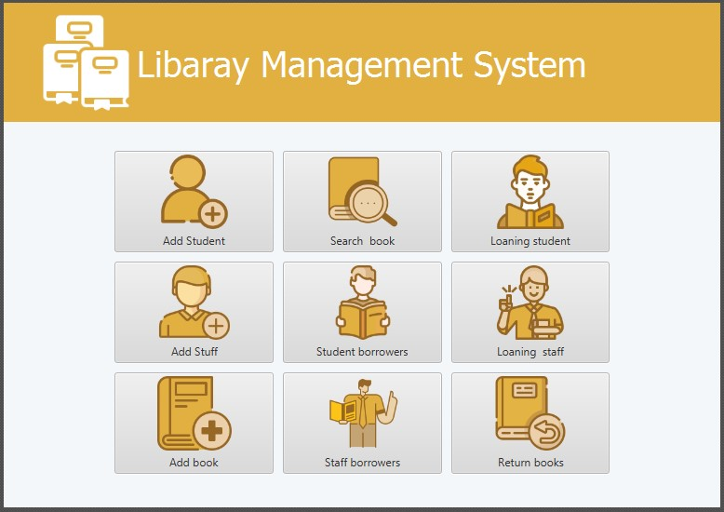
Graphic Interfaces :

Slide 15
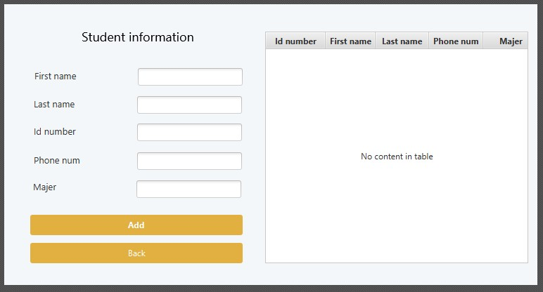
Add student :

Slide 16
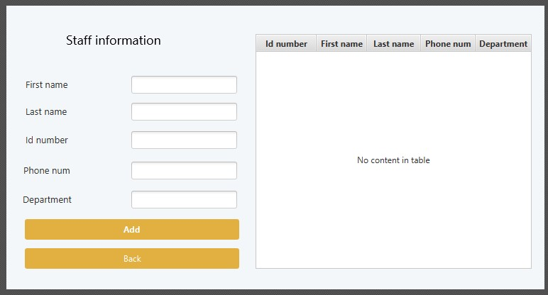
Add staff :

Slide 17
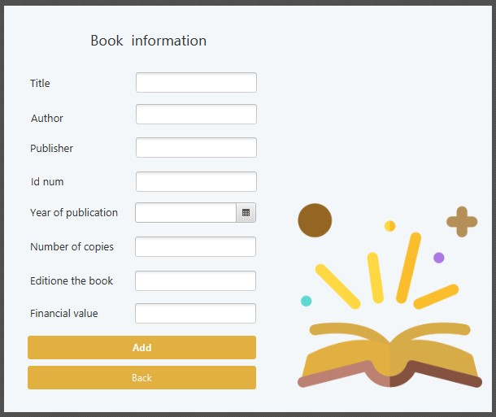
Add book :

Slide 18
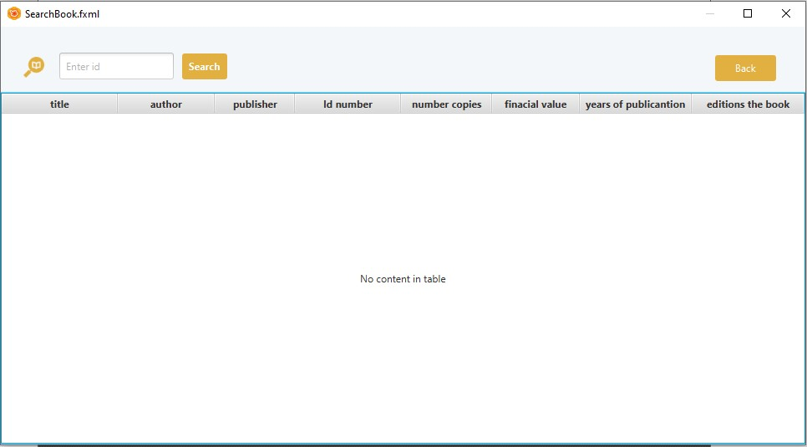
Search book :

Slide 19
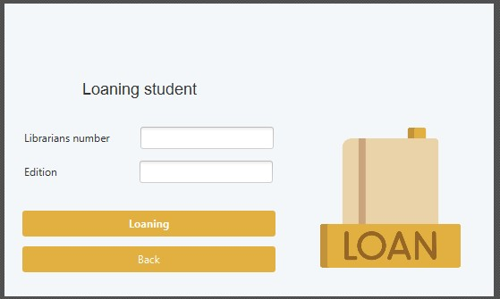
Loaning student.

Slide 20
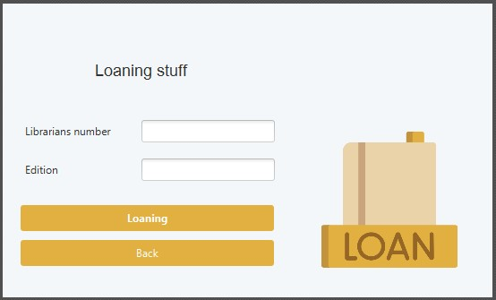
Loaning staff :

Slide 21
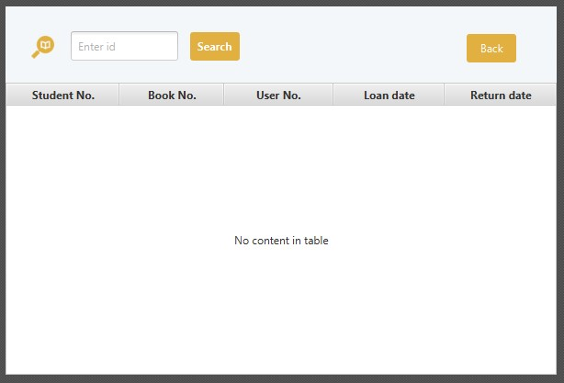
Borrow Staff :

Slide 22
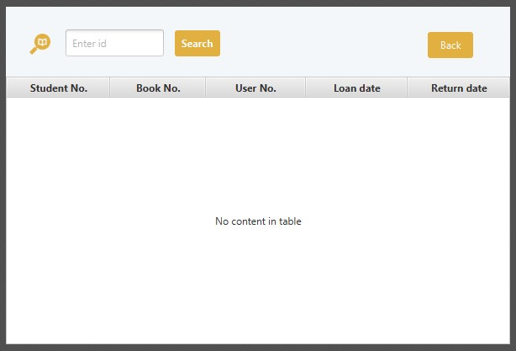
Borrow student :

Slide 23
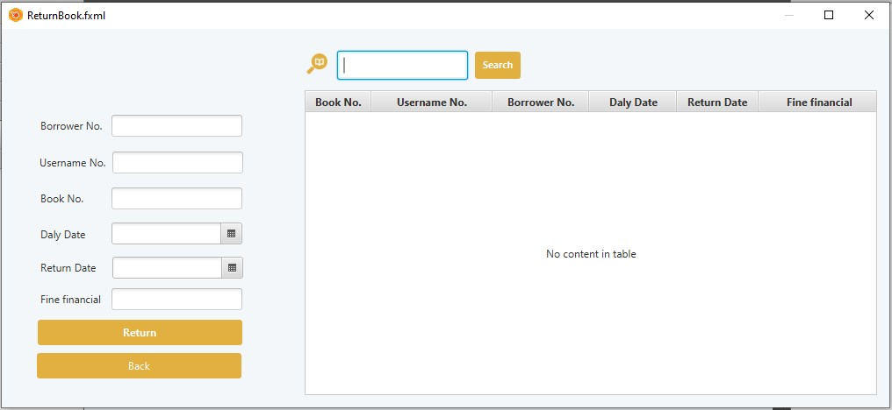
13.Return book :

Slide 24
3.DataBase:
In this project , a database was crated using Oracle and 8 tables were created :
1.BOOKS.
2.USERS.
3.STUDENTS.
4.STAFFS.
5. BORROW_STAFF.
6. BORROW_STDUDENT.
7. S_RETURNED_BOOKS.
8. ST_RETURNED_BOOKS.

Slide 25
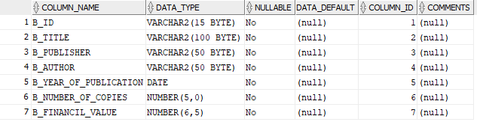
BOOKS

Slide 26
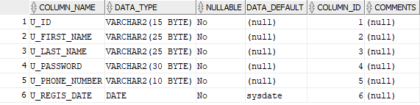
USERS

Slide 27
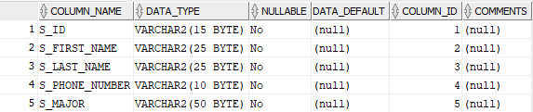
STUDENTS

Slide 28
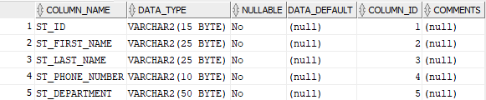
STAFFS

Slide 29
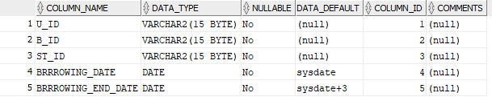
BORROW_STAFF

Slide 30
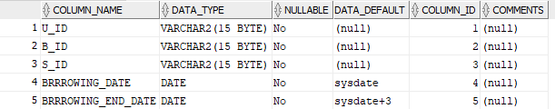
BORROW_STDUDENT

Slide 31
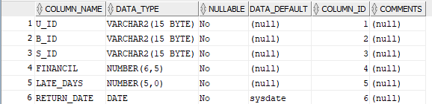
S_RETURNED_BOOKS

Slide 32
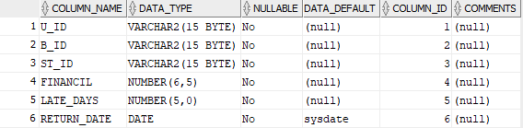
ST_RETURNED_BOOKS

